Slide 1
CMD OPEN HOUSE

Slide 2
CMD OPEN HOUSE
EMPLOYEE SCREEN

Slide 3
CMD OPEN HOUSE
OPTION - I
Welcome to CMD Open House
Please note that matters related to personal issues like Transfer, Promotion, Placement, ACR, Personal grievances, APE, DPC etc. shall not be entertained in CMD Open House platform.
OK

Slide 4
CMD OPEN HOUSE
OPTION - II
Welcome to CMD Open House
Please refrain from raising personal issues like Transfer, Promotion, Placement, ACR, Personal grievances, APE, DPC etc. in CMD Open House platform.
OK

Slide 5
CMD OPEN HOUSE
Welcome Sh. Sunil Kumar
Archive
Area
Area
Policy
Strategy
R&D
New Initiative
Upgradation
Innovation
Governance
System Improvement
Others
Related Directorate
BD
Finance
HR
Marketing
Projects
Related Directorate
Subject
200
Description
5000
Submit

Slide 6
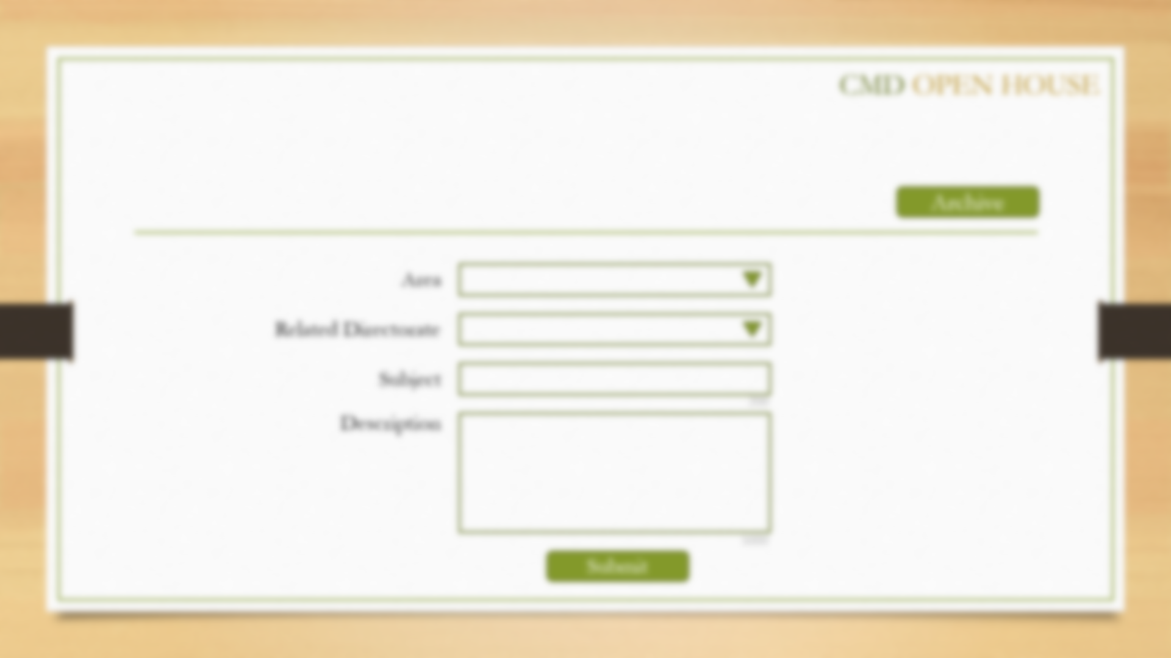
Your request ID 2415 is submitted.

Slide 7
CMD OPEN HOUSE
MANAGEMENT SCREEN

Slide 8
CMD OPEN HOUSE
Inbox
Outbox
Accepted
Rejected
ID | Requester | Date | Related Directorate | Subject | New / In process | View
View
View
View
View
View

Slide 9
Request ID: 2415
CMD OPEN HOUSE
Requester Name
Designation
Pending with
Location
Pending from
Request Date
Area
Comments By | Date | Comment
Related Directorate
Subject
Description
Forward
Reply
Close

Slide 10
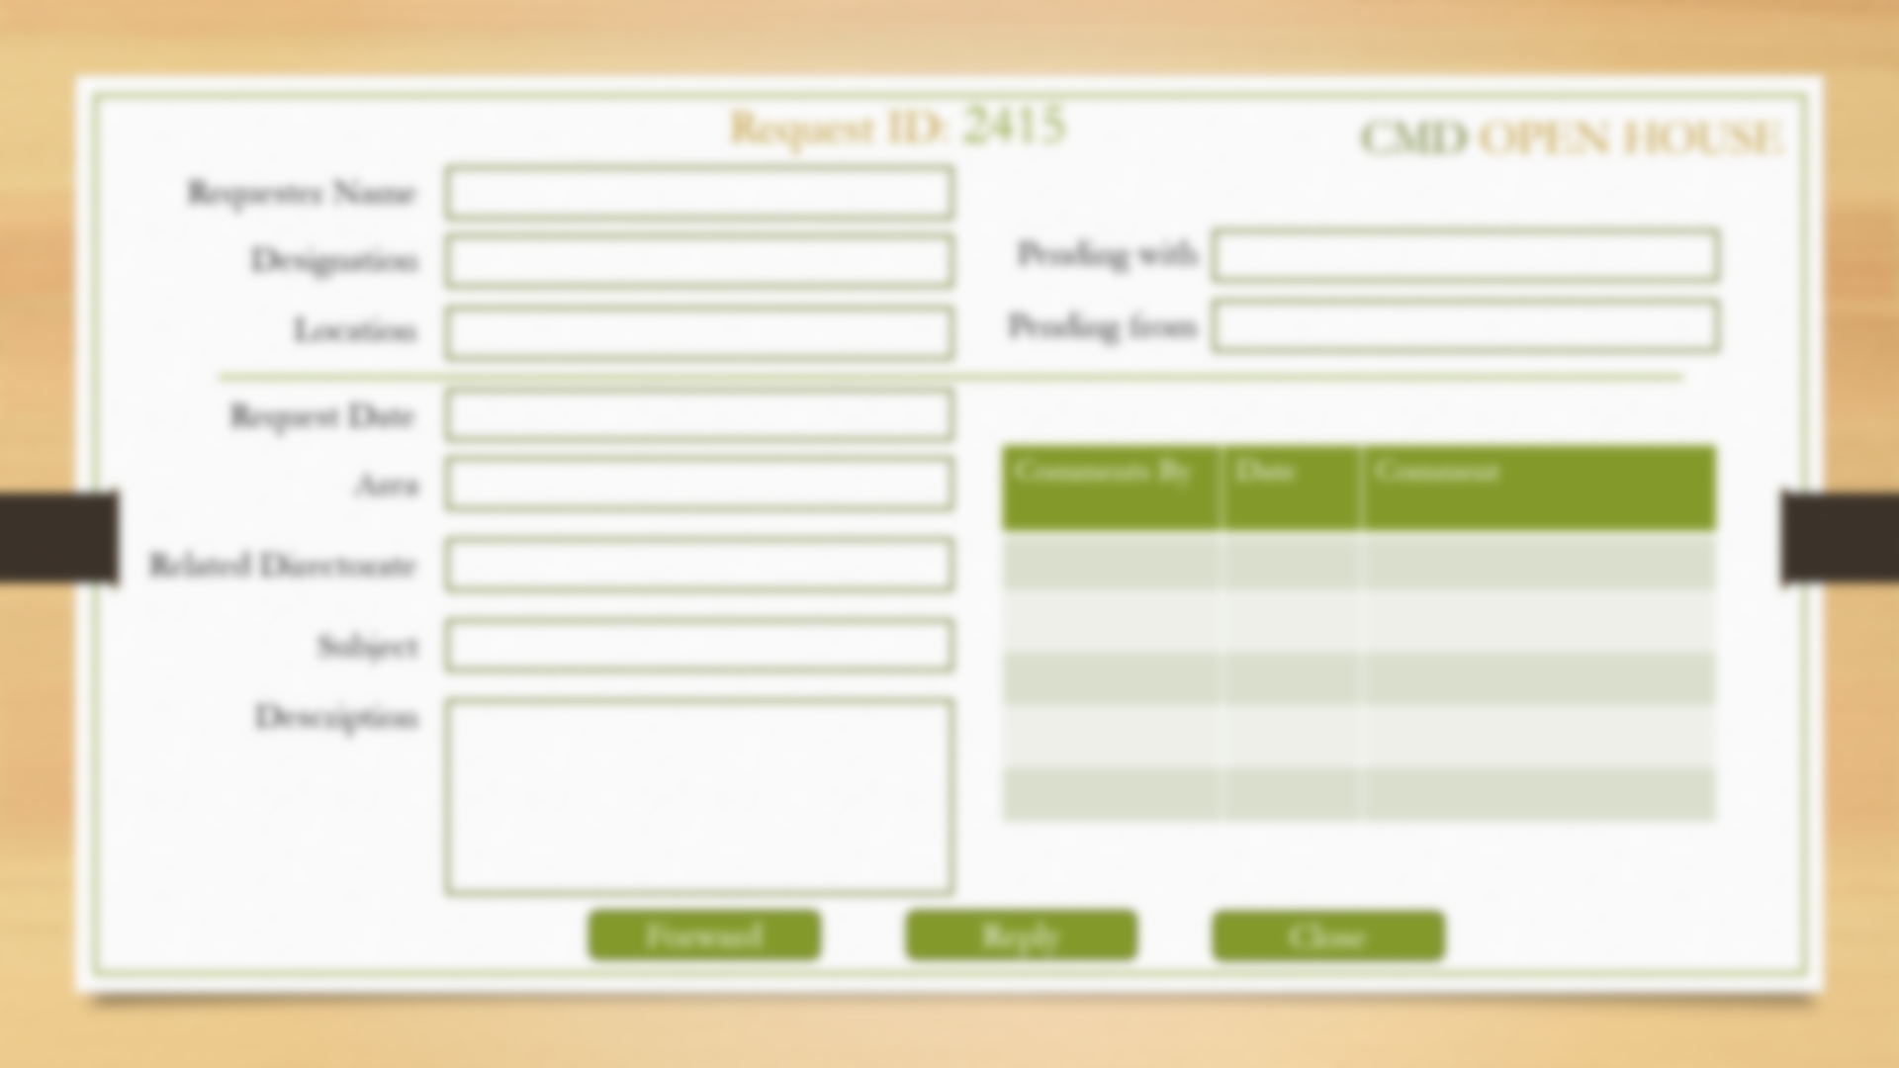
Applicable for CMD
Applicable for Directors & EDs
Applicable for CMD & Directors
Accepted / Rejected
Send to
Send to
Comments
Comments
Comments
5000
5000
5000
Submit
Submit
Submit
Forward
Reply
Close

Slide 11
CMD OPEN HOUSE
Inbox
Outbox
Accepted
Rejected
ID | Requester | Date | Related Directorate | Subject | New / In process | View
View
View
View
View
View

Slide 12
Thank You

